Slide 1

Shape Completion with Prediction of Uncertain Regions
Matthias Humt, Dominik Winkelbauer and Ulrich Hillenbrand
Notes:
Welcome to this presentation on Shape Completion with Prediction of Uncertain Regions

Slide 2
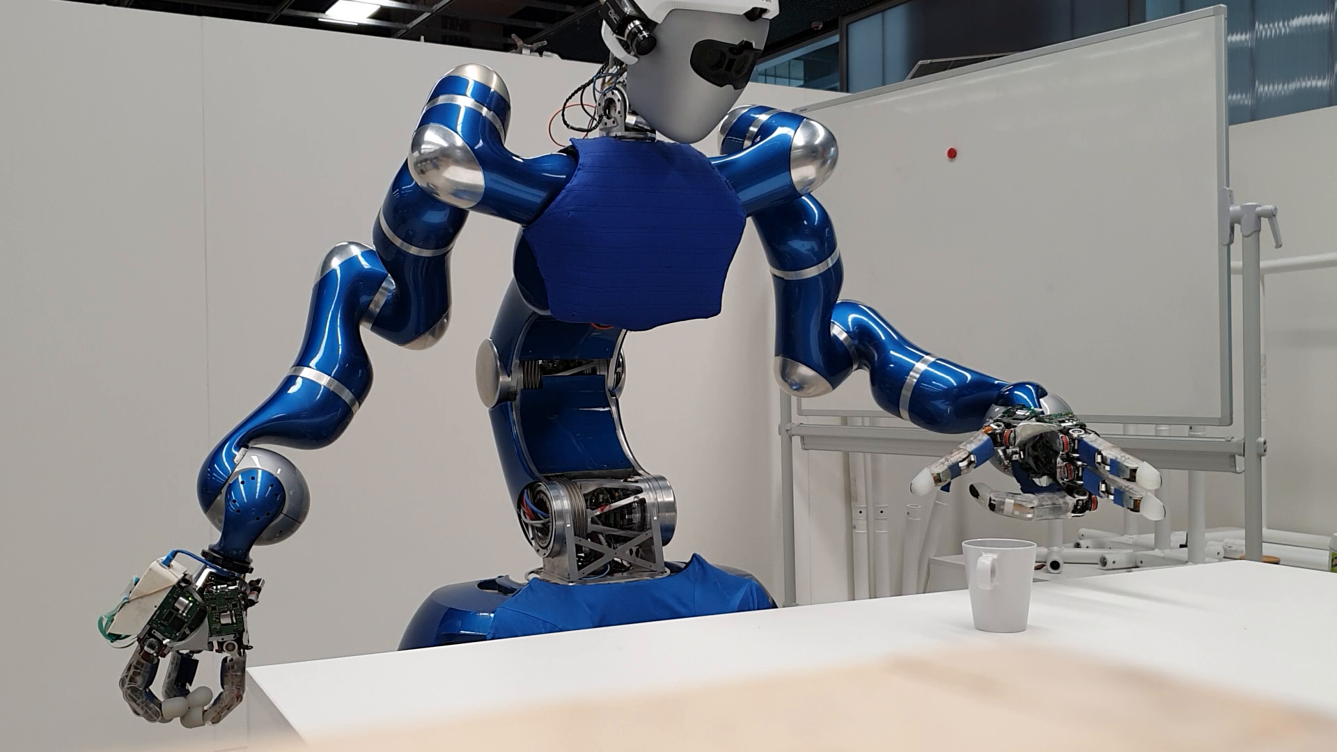

Motivation
Notes:
To motivate this work, consider the problem of robotic manipulation with complex grasps, for example by our humanoid robot Agile Justin.
To succeed, we must reason about object properties based on limited and noisy sensor data [click], like a single depth image from the head-mounted RGB-D camera.

Slide 3
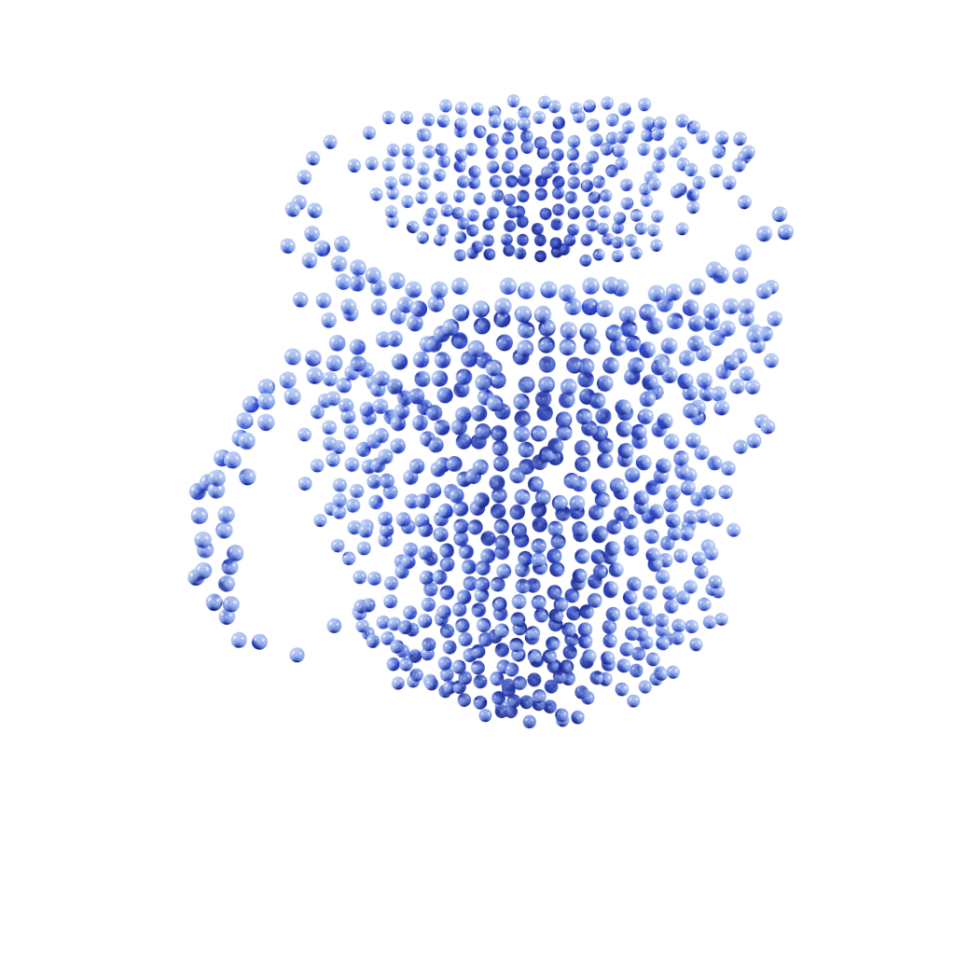
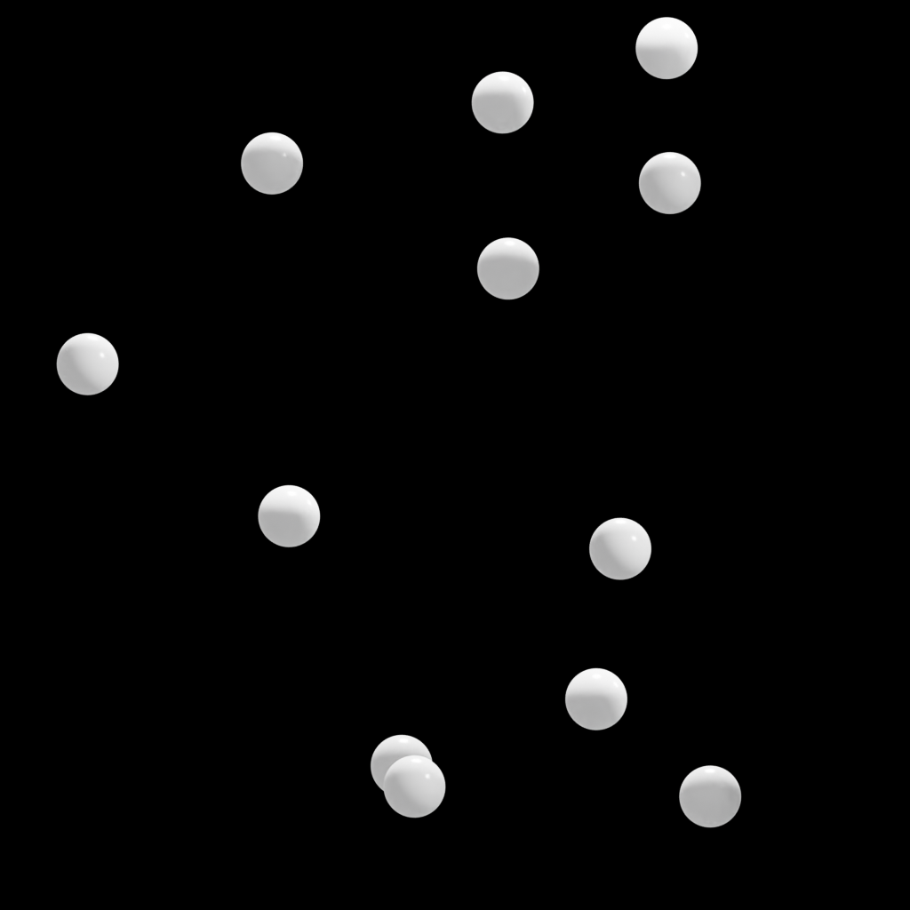
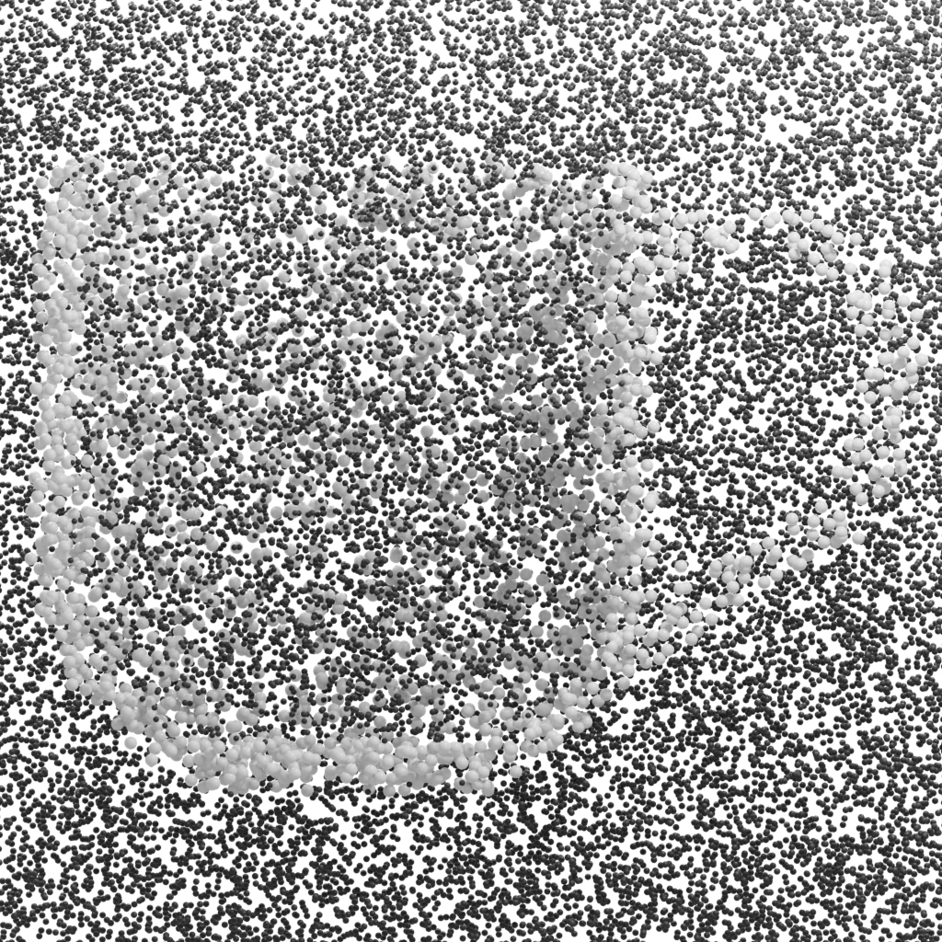





Shape Completion
continuous query points
1
feature
encoder
decoder
1
1. point cloud (simulation)
2. convolutional occupancy network
3. predicted occupancy probabilities
[1] Mescheder et al.: Occupancy Networks: Learning 3D Reconstruction in Function Space
[2] Peng et al.: Convolutional Occupancy Networks
Notes:
We obtain a partial point cloud representation of the front of the object through projection of the depth image using known camera intrinsics. [click]
We then learn to predict the complete shape [click] through binary classification of continuously sampled query points [click] using the convolutional occupancy network by Peng et al. [click]
The surface of the object is implicitly defined by the decision boundary that separates occupied from free space, based on threshold tau.

Slide 4

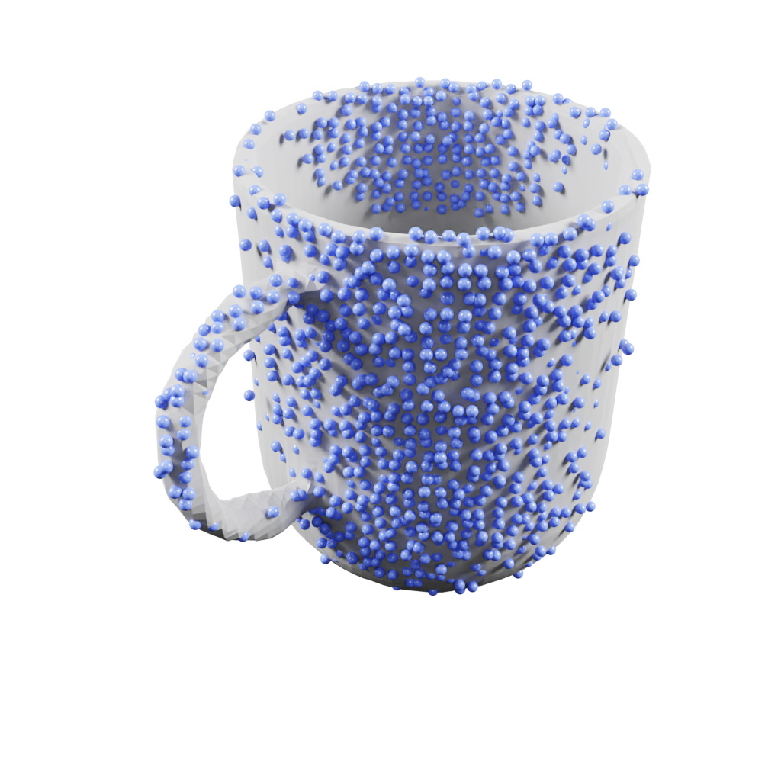
Shape Completion
grid of query points
feature
encoder
decoder
1. point cloud (simulation)
2. convolutional occupancy network
3. shape completion (marching cubes)
[1] Mescheder et al.: Occupancy Networks: Learning 3D Reconstruction in Function Space
[2] Peng et al.: Convolutional Occupancy Networks
Notes:
Sampling on a regular grid permits the extraction of a triangle mesh using the marching cubes algorithm which is the preferred representation for many downstream tasks.

Slide 5
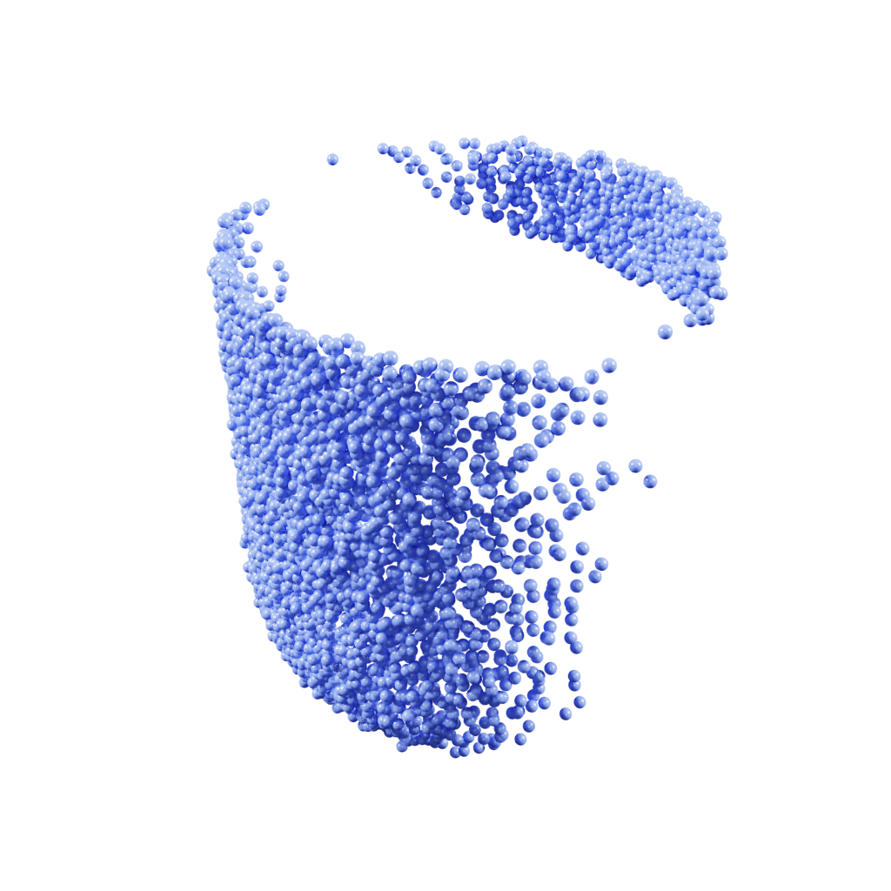
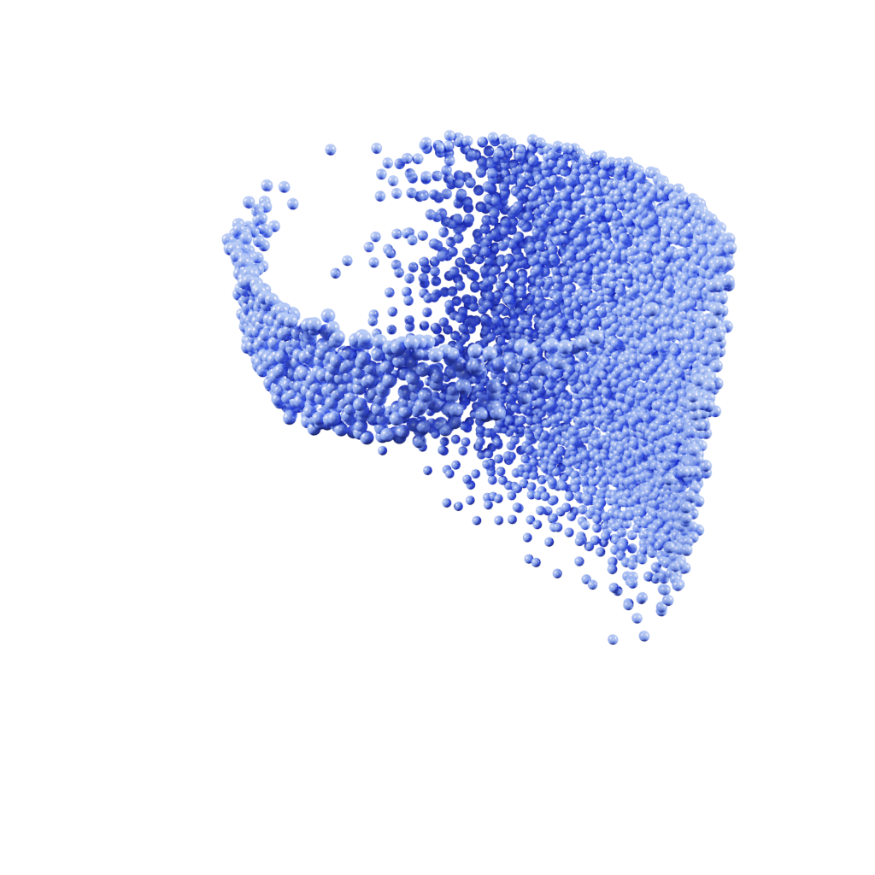
Motivation: Pose Ambiguity
front view
back view
Notes:
Problems arise when the given input is ambiguous due to missing data from self-occlusion.

Slide 6
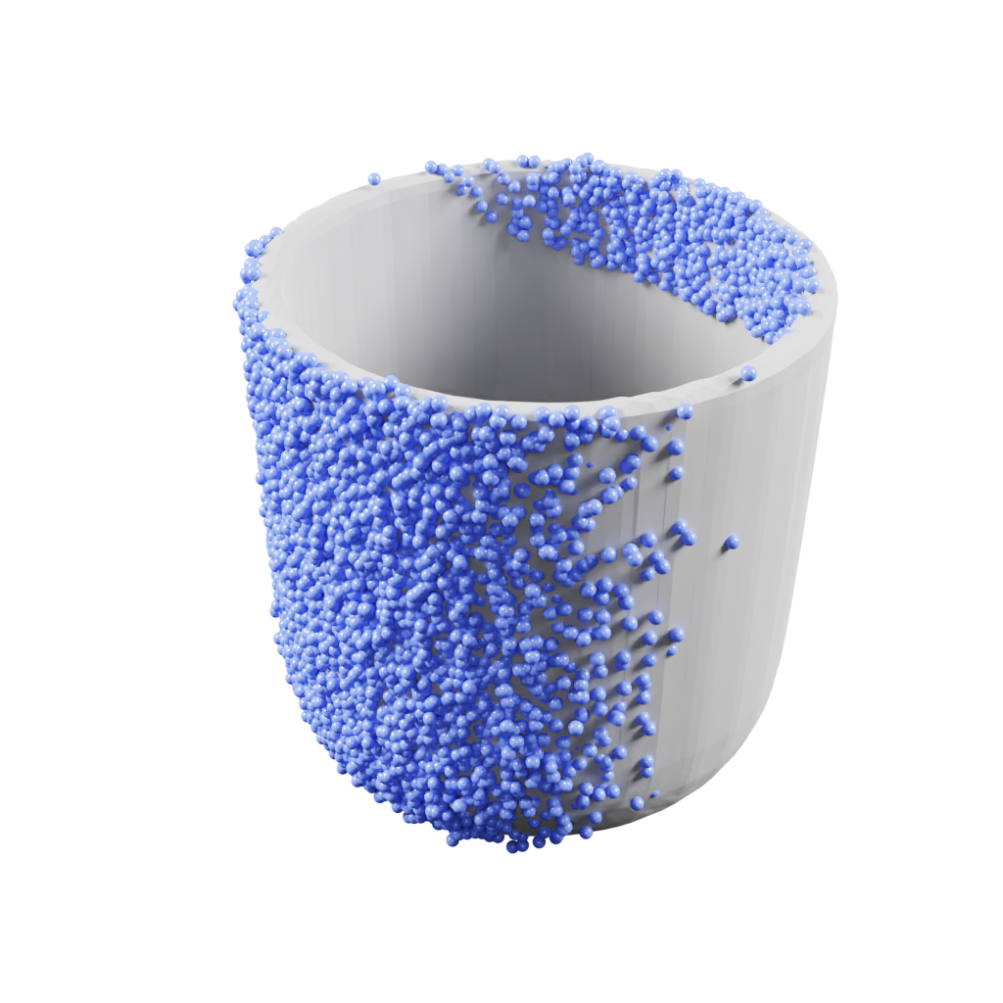
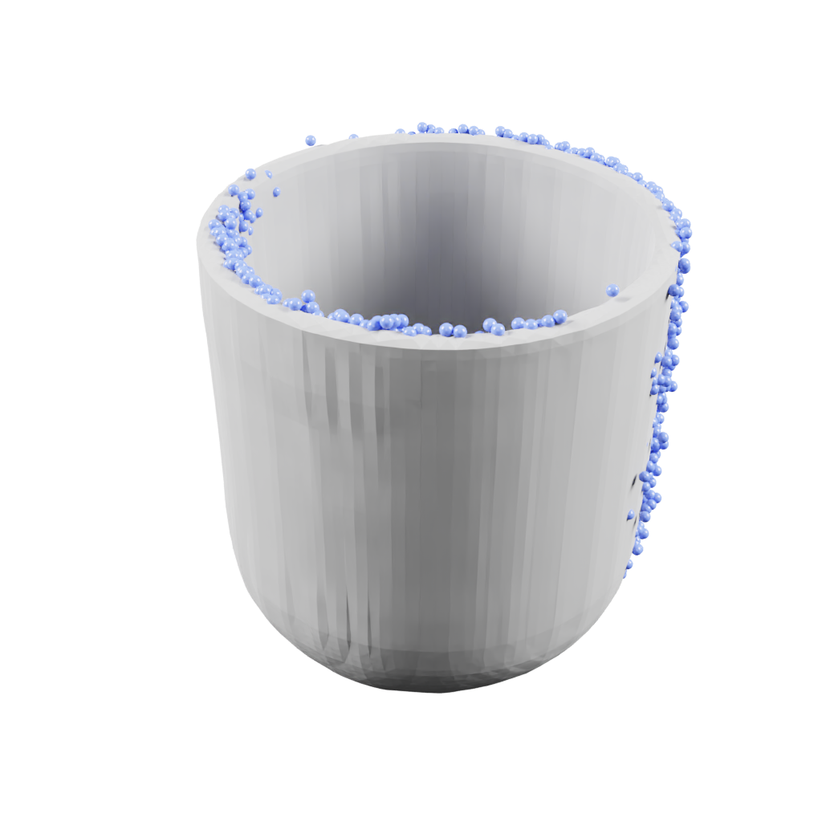
Motivation: Pose Ambiguity
front view
back view
Notes:
In our representative example of a mug, the fully supervised training results in average predictions across all views with fully occluded handle and low occupancy probability for each plausible individual handle position.

Slide 7
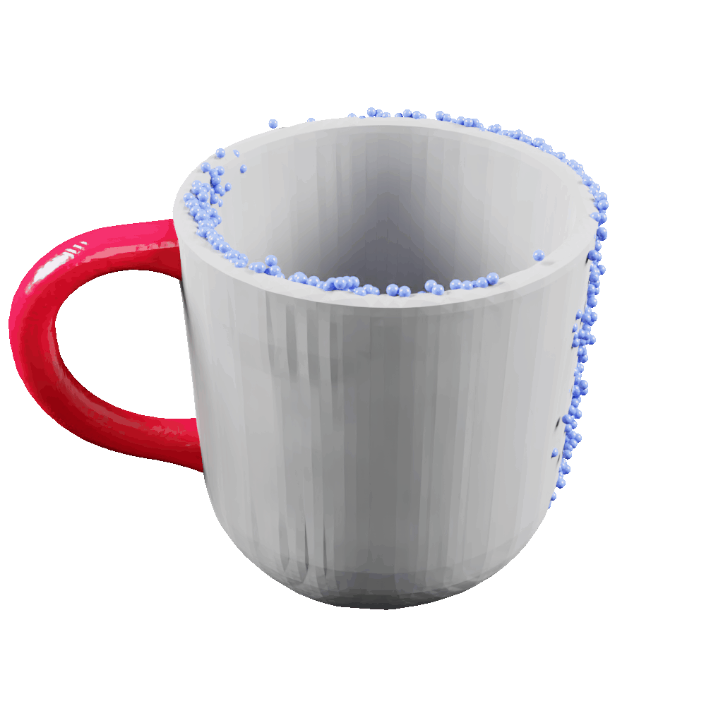
Motivation: Pose Ambiguity
front view
back view
Notes:
But plausible yet wrong handle placement is equally undesirable.

Slide 8
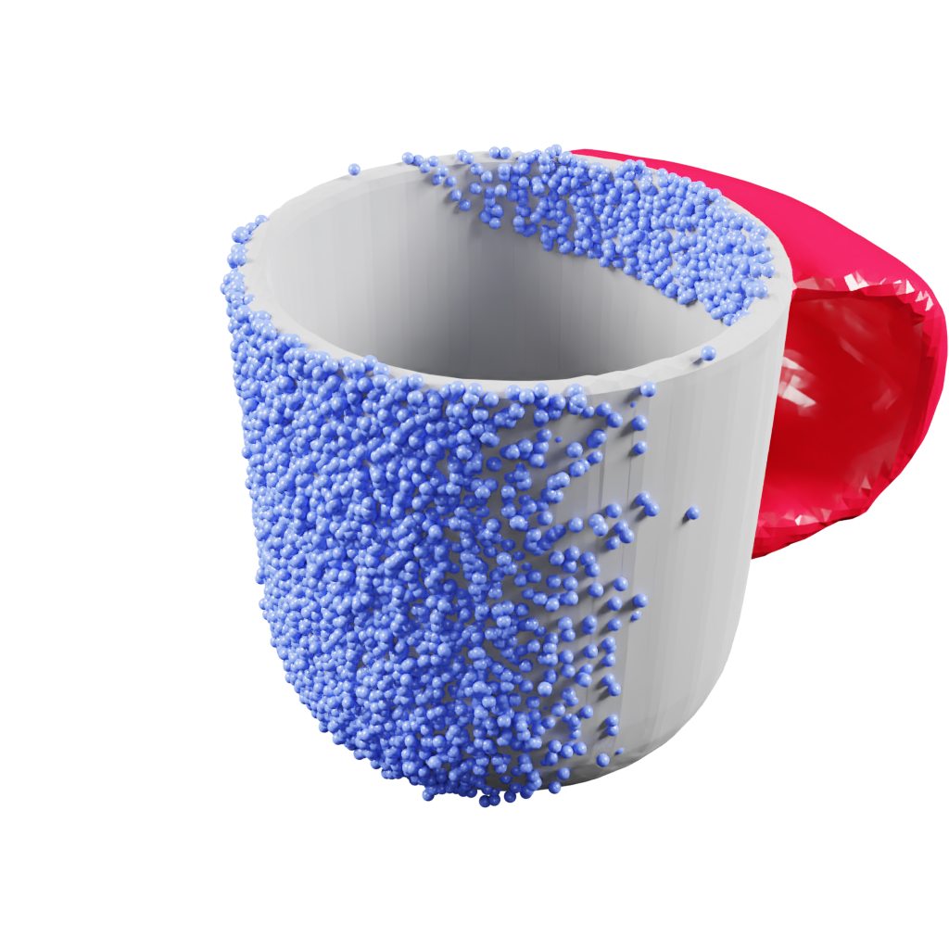
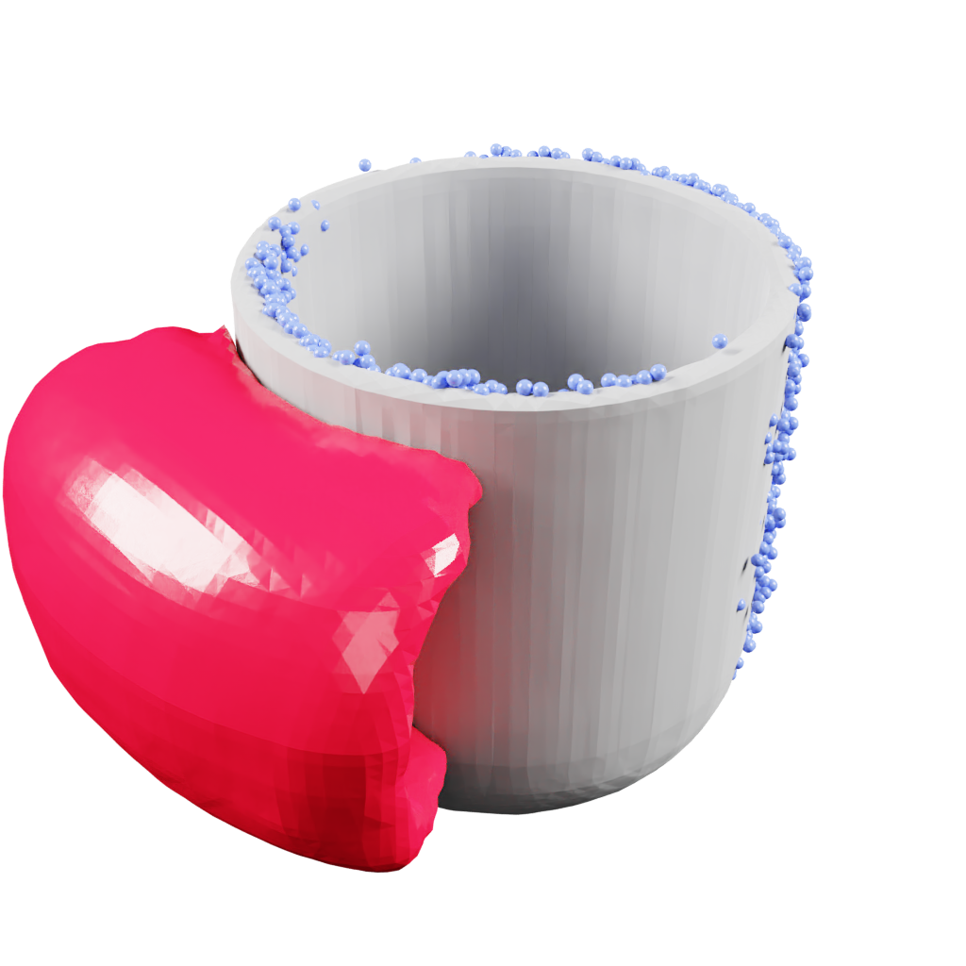
Motivation: Uncertain Regions
front view
back view
Notes:
Instead, a region containing all possible handle positions would be highly beneficial for downstream tasks such as collision avoidance in grasping.
This kind of uncertainty stems from observational ambiguity and persists even under perfect observability and knowledge of model parameters and object geometry.
It is therefore distinct from other types of uncertainty such as epistemic or aleatoric uncertainty.

Slide 9
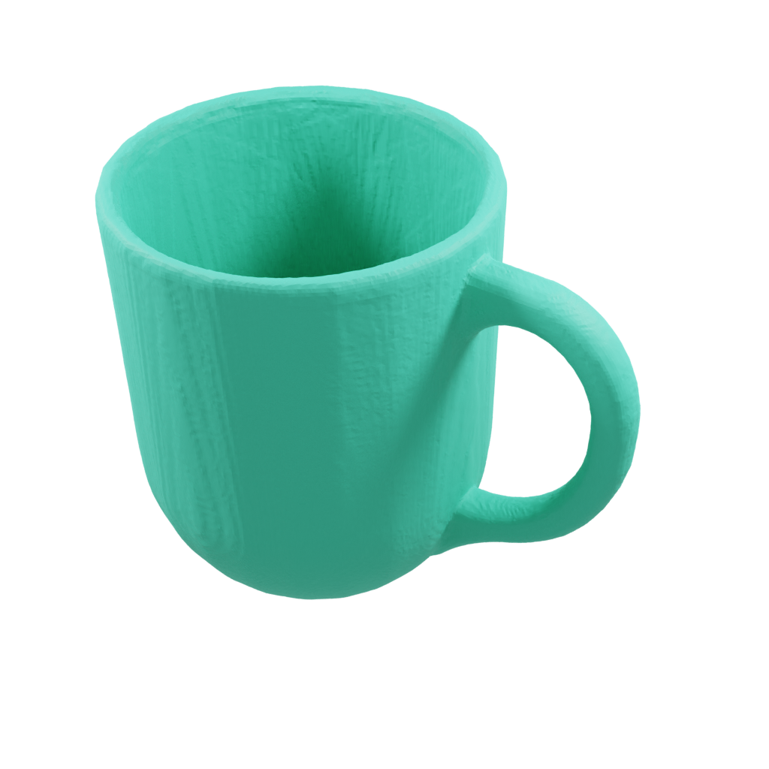
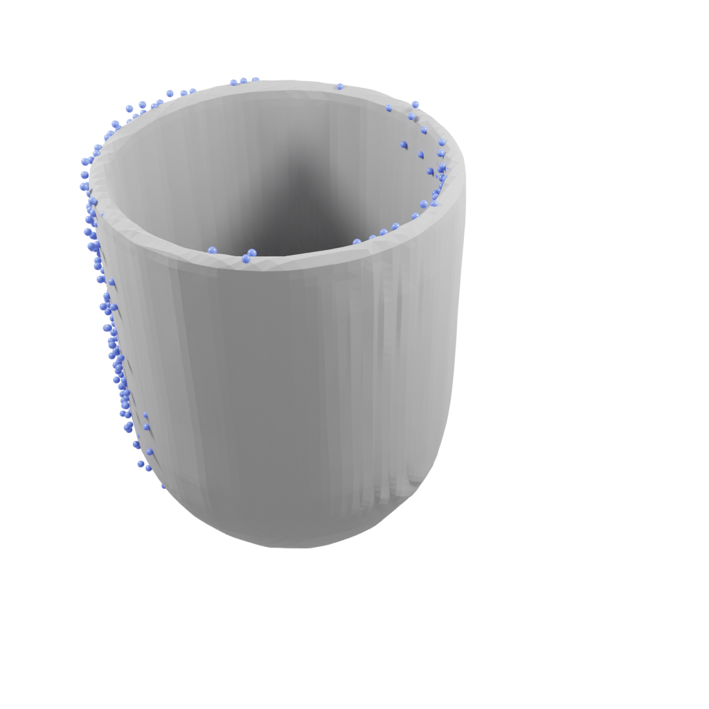
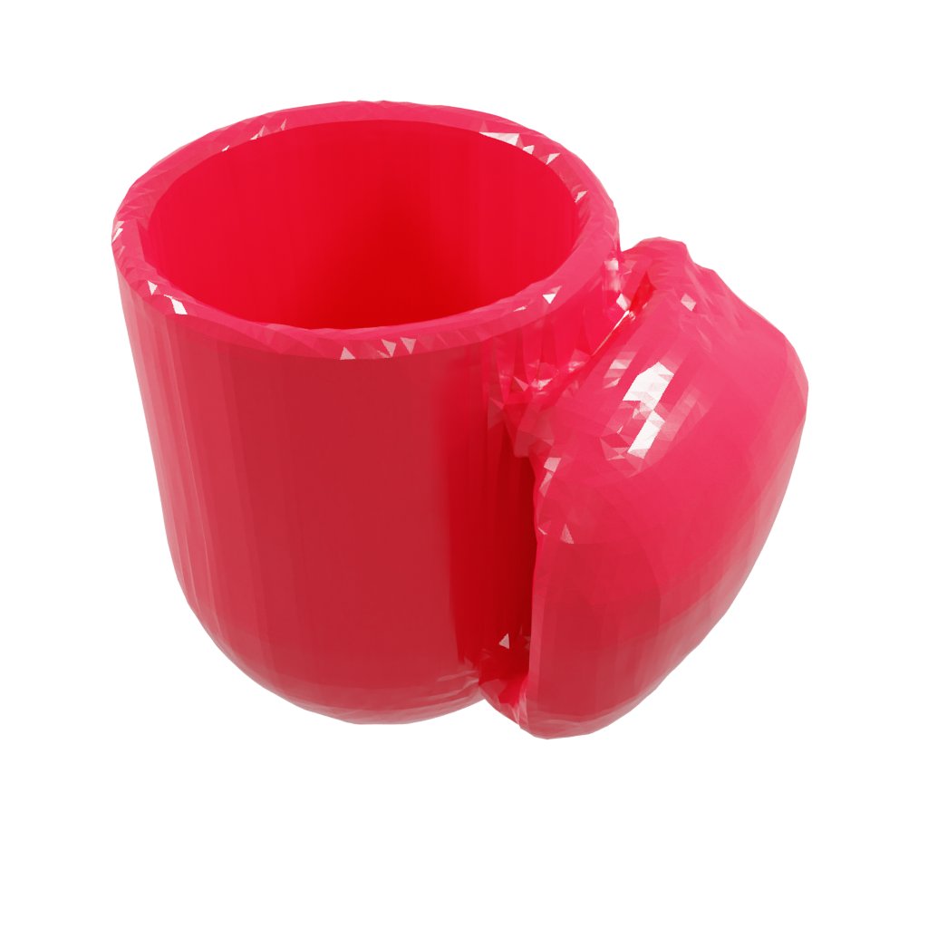


Approach 1: Gradient Threshold
ground truth
predicted occupied
predicted uncertain
Notes:
Recalling that regions with lower occupancy probability can be extracted by decreasing the threshold, [click] a naive approach to obtaining such uncertain regions involves the identification of two such thresholds, bounding the region between free and occupied space.

Slide 10
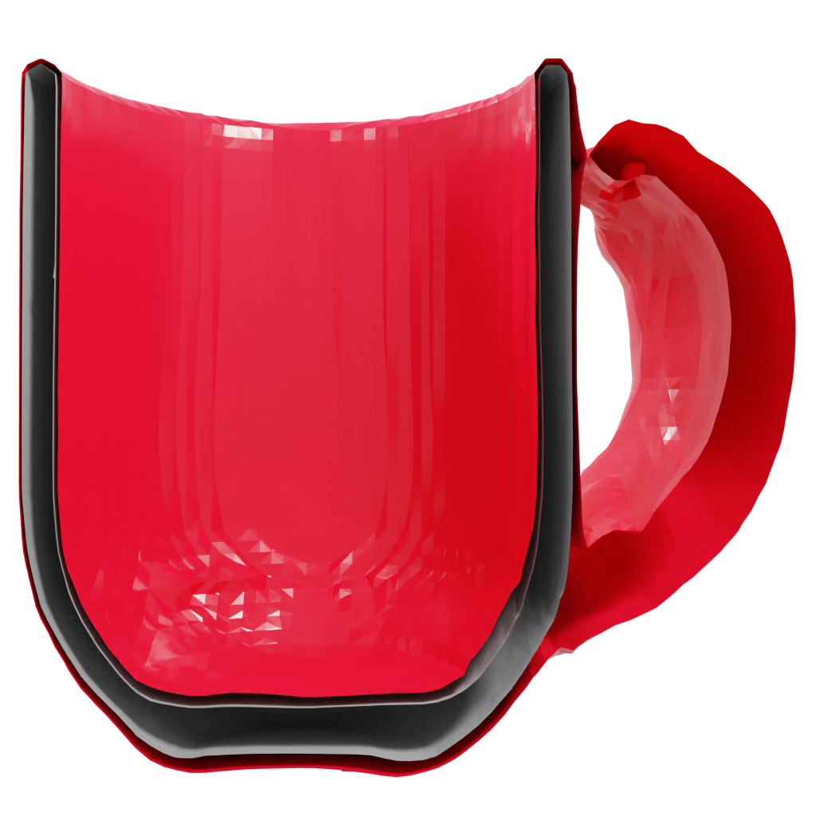
Approach 1: Gradient Threshold
ground truth
predicted occupied
predicted uncertain
Notes:
However, regions with lower occupancy scores inevitably encompass those with higher scores, rendering the truly occupied regions inaccessible.
We therefore need a way to differentiate between narrow uncertain regions occurring near the object’s surface and more extended ones reaching farther out.

Slide 11
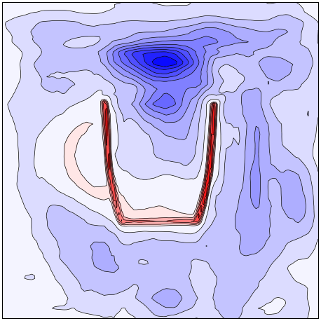
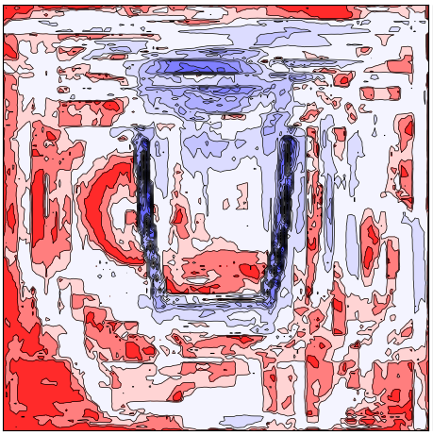
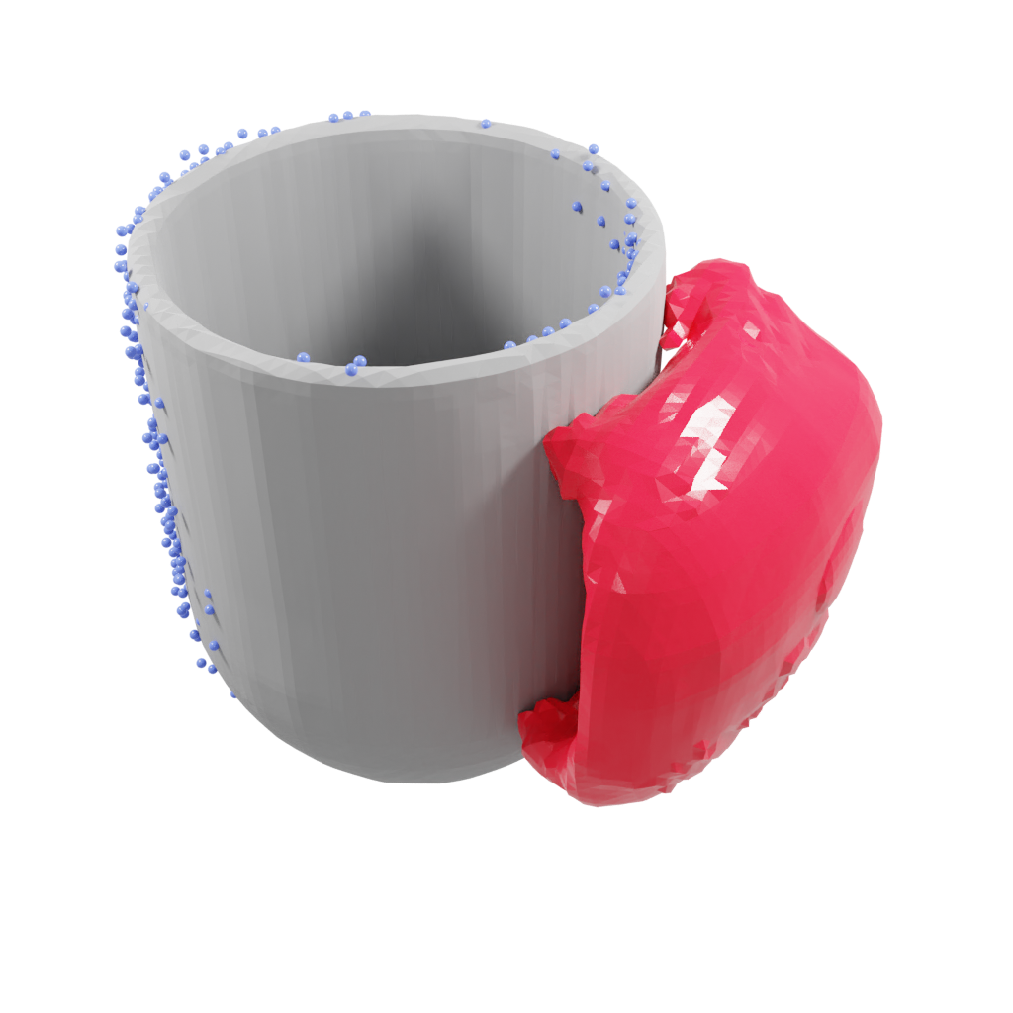
Approach 1: Gradient Threshold
=
⋂
a: predicted occupancy probability
b: gradient magnitude of (a) w.r.t. the query
c: shape completion & uncertain region
Notes:
One possible approach to circumvent this issue is based on the realization, that we can expect the gradient [click] of the predicted occupancy probability with respect to the position of a given query point to be large close to the decision boundary defining the object's surface while it should be smaller farther away from it. [click]
We extract bounded uncertain regions as the intersection of areas where both the predicted occupancy probability and the magnitude of this gradient are within range of their respective thresholds.
We refer to this approach as “binary”.

Slide 12
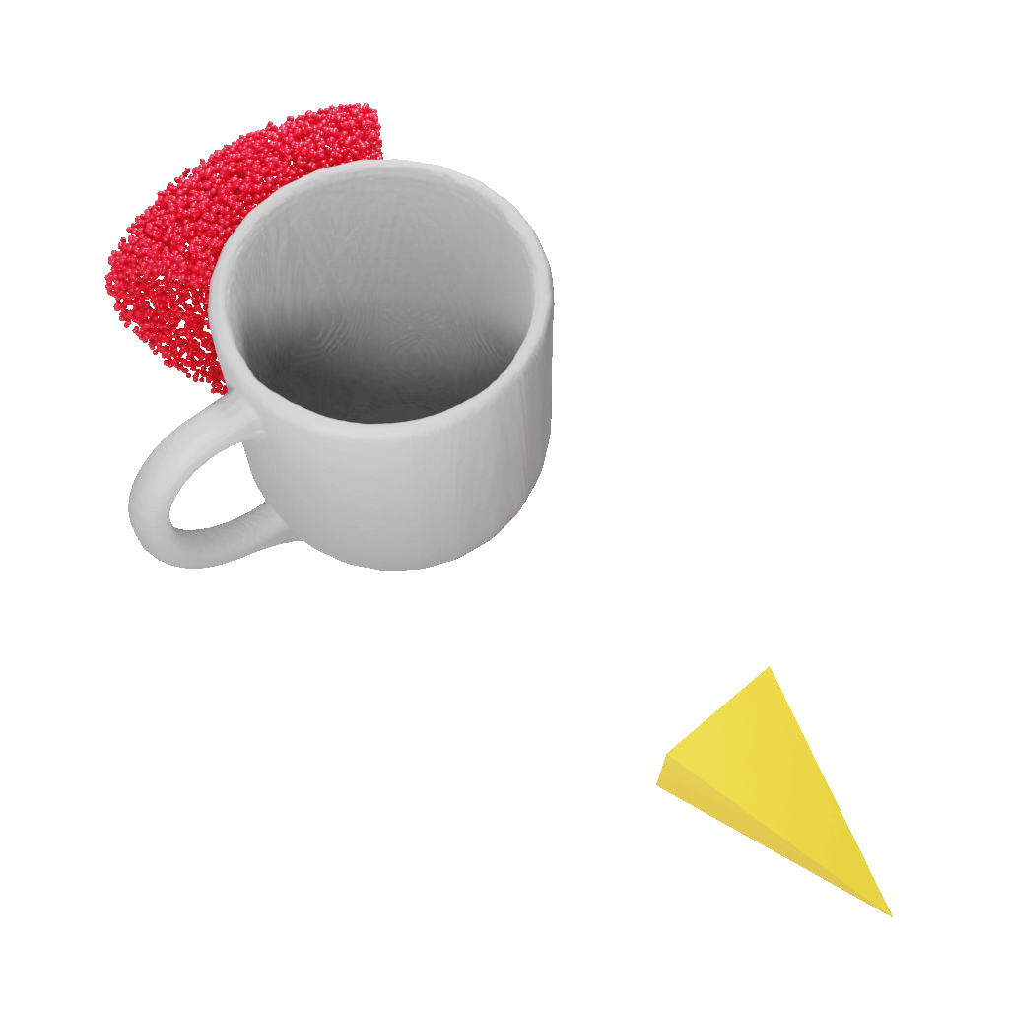
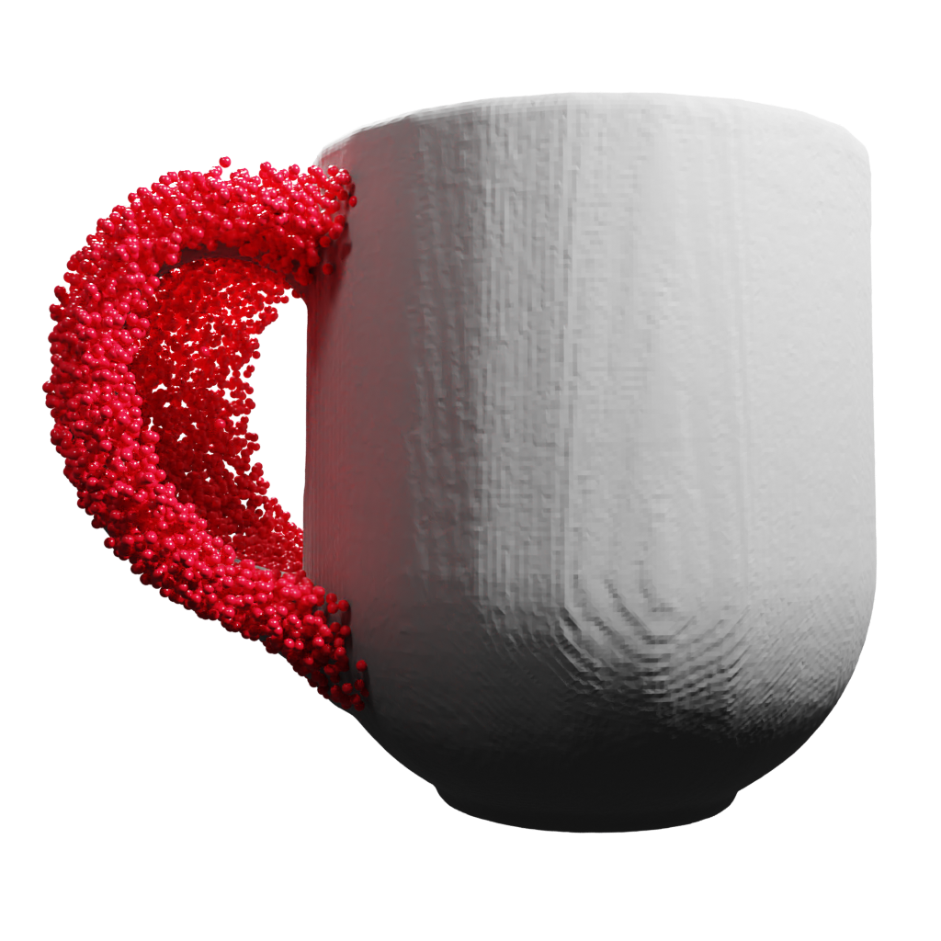
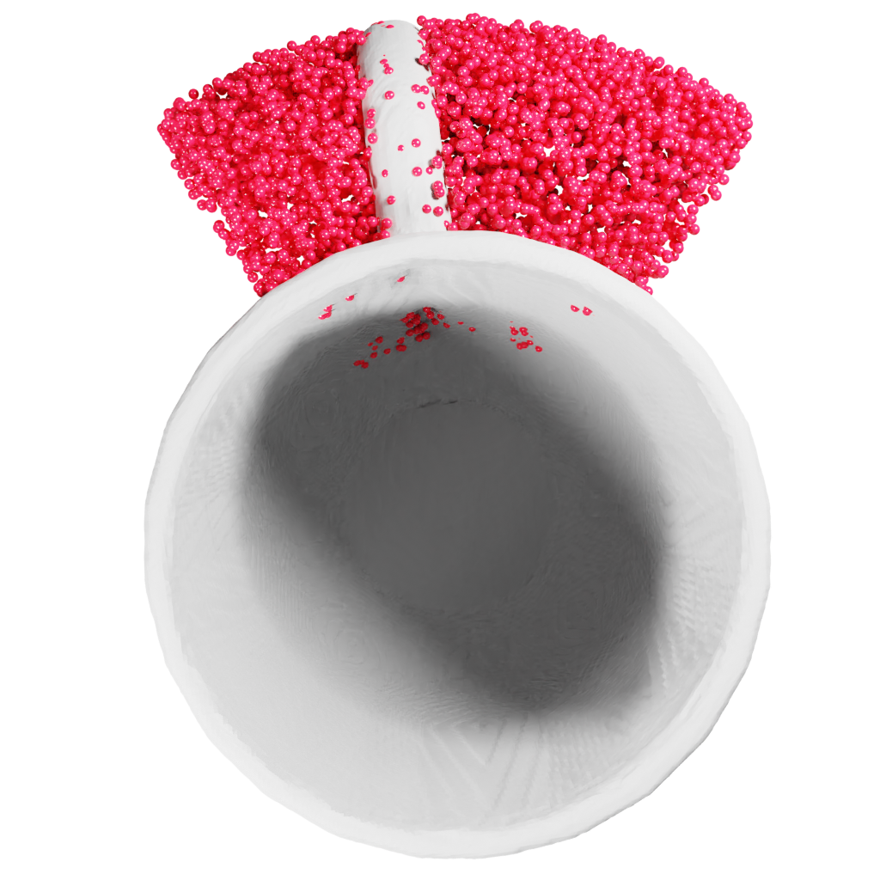


Approach 2: Additional Label
rotations
virtual camera
side view
top view
Notes:
The exact extent of uncertain regions can also be computed analytically using a similarity measure of partial views from multiple object orientations.
We obtain such ground truth labels for training through simulation of all orientations that might plausibly yield similar partial observations [click] which elevates the given problem from binary to trinary classification. [click]
We therefore refer to this second approach as “trinary”

Slide 13
Experiments
Novel View: Generalize to new viewpoints of known object instances
Novel Instance: Generalize to new instances of a known class
Sim2Real: Generalize from simulated to real data
Notes:
We perform three types of experiments to evaluate the ability to accurately predict free, occupied and uncertain regions and the implications on the downstream task of robotic grasping.
We progressively increase the difficulty of the problem from generalizing to novel views, novel instances and finally to real world data.

Slide 14






Evaluation: Metrics
FN: false negative
FP: false positive
TN: true negative
TP: true positive
confusion matrix
FN
TN
TP
FP
prediction
ground truth
harmonic mean between precision & recall
Notes:
The performance of region segmentation is evaluated using standard volumetric metrics derived from entries of the confusion matrix of binary classification problems.

Slide 15



Evaluation: Grasping
occ: occupied space
unc: uncertain space
confusion matrix
Grasp Collision Risk:
FN
TN
Grasp Miss Risk:
TP
FP
Grasp Exclusion Risk:
prediction
ground truth
Notes:
Based on the same entries, we introduce three novel metrics to measure the risk of unexpected collision, grasping of empty space and rejecting feasible grasp candidates because they are blocked by false prediction of occupied or uncertain regions.

Slide 16
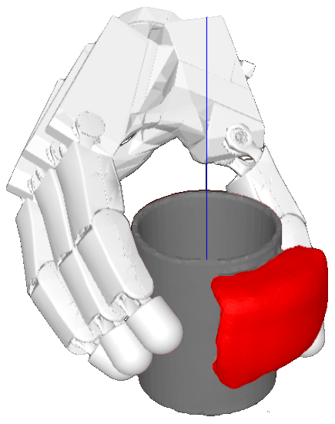
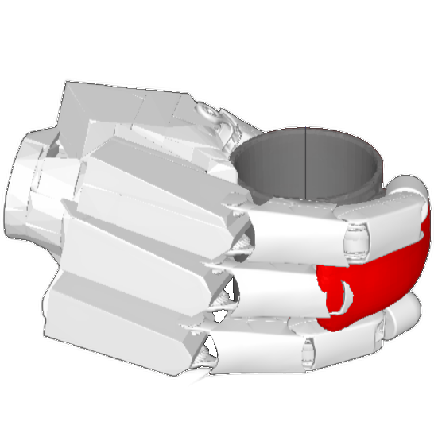
Evaluation: Grasping
ignoring uncertain region
considering uncertain region
Improved Epsilon Quality metric (IEQ): “The minimal external force applied to the ground truth object mesh that would break the grasp.”
[3] Winkelbauer et al.: A two-stage learning architecture that generates high-quality grasps for a multi-fingered hand
Notes:
Ignoring uncertain regions during grasping can lead to collisions and unstable grasps. [click]
We use the improved epsilon quality metric by Winkelbauer et al. to measure the quality of grasps as the minimal external force applied to the ground truth object mesh that would break the grasp.

Slide 17
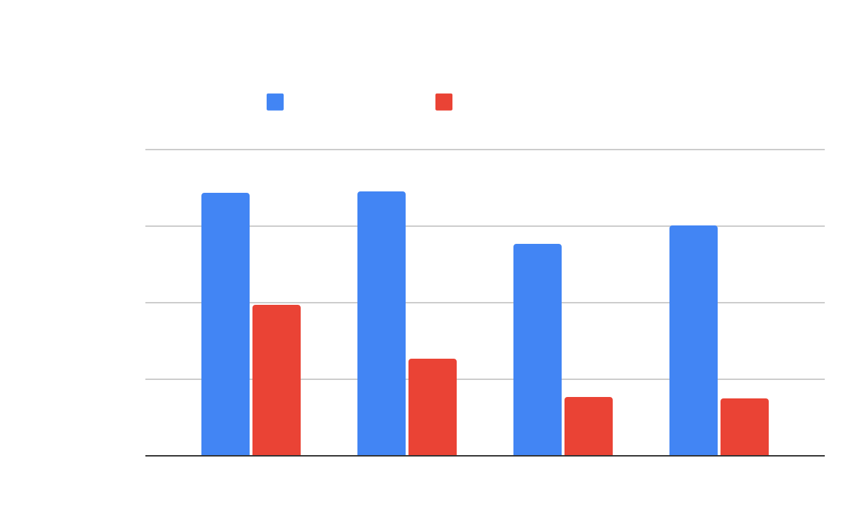
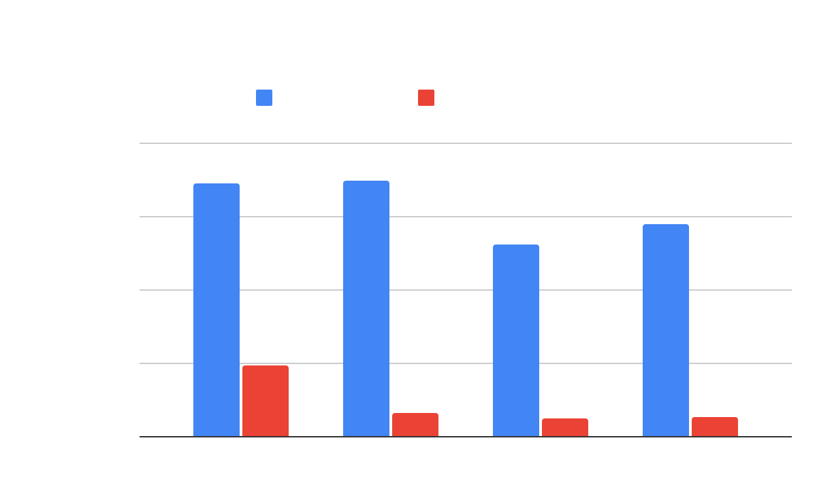
Results: Novel View & Instance
F1-Score
F1-Score
*ours
Notes:
In the novel view and novel instance experiments, we find that our proposed “trinary” and “binary” methods outperform variational autoencoder and dropout baselines for both occupied and uncertain region prediction.

Slide 18
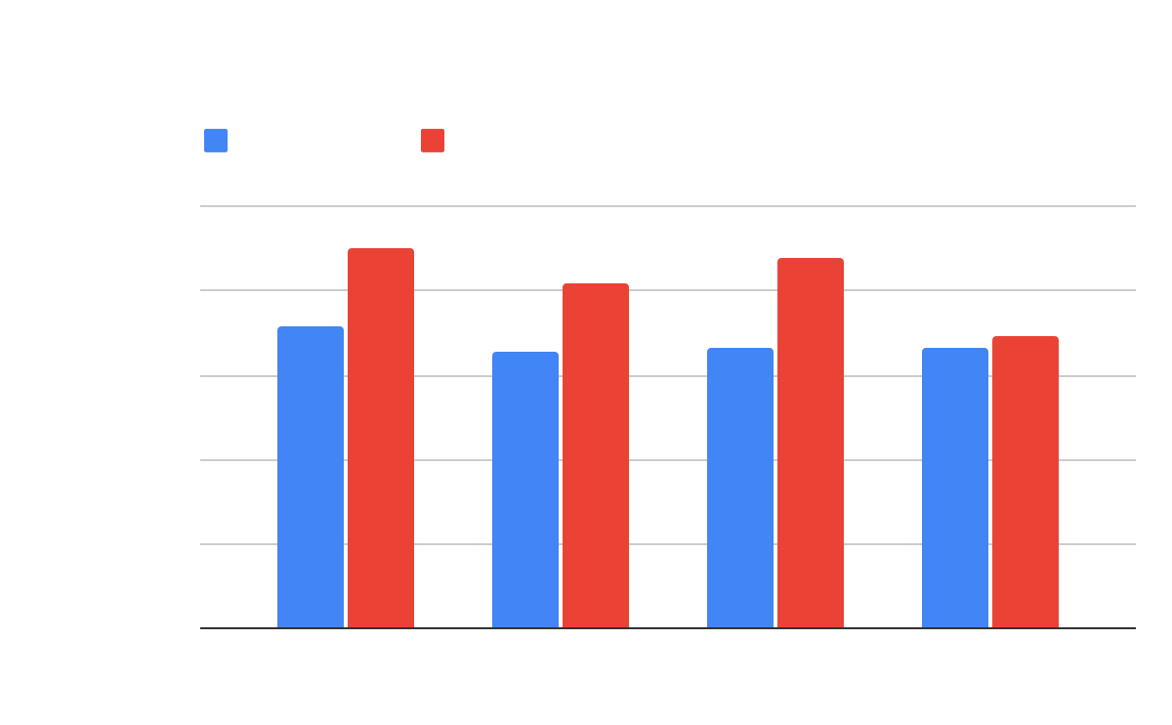
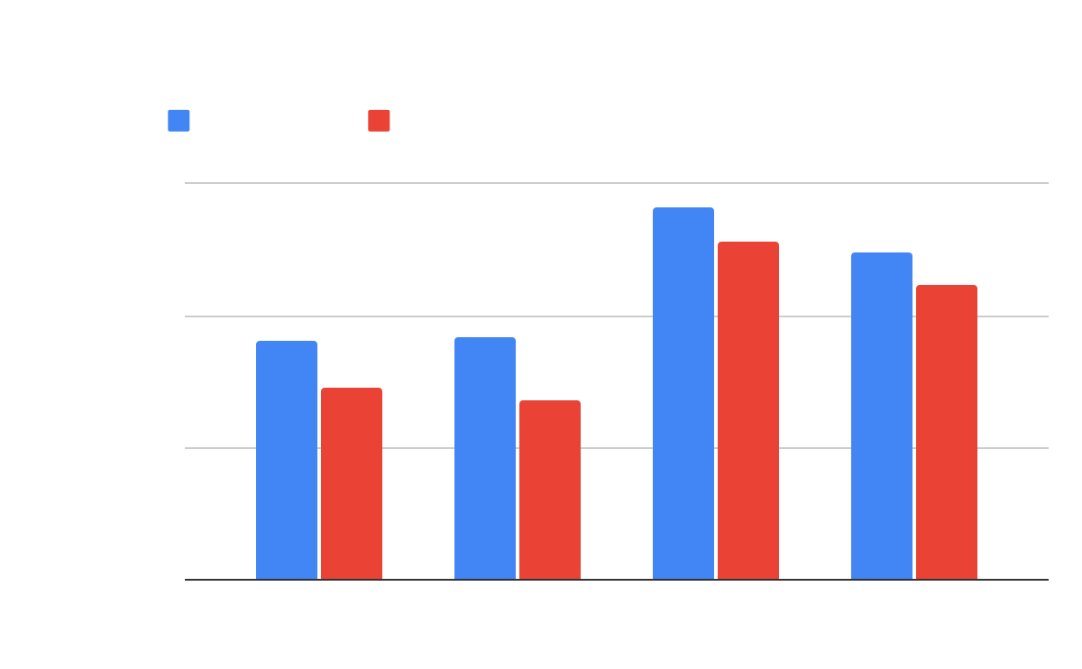
Results: Novel View Grasping
Improved Ɛ-Quality
Grasp Collision Risk
*ours
Notes:
We further validate the utility for grasping, where filtering of grasp candidates predicted on the shape completion that collide with the predicted uncertain region leads to significant improvement [click] of the grasp quality for the binary, trinary and vae methods. [click]
This is consolidated by the evaluation of the grasp collision risk where our trinary and binary methods [click] outperform the baselines.
Further results can be found in the paper.

Slide 19
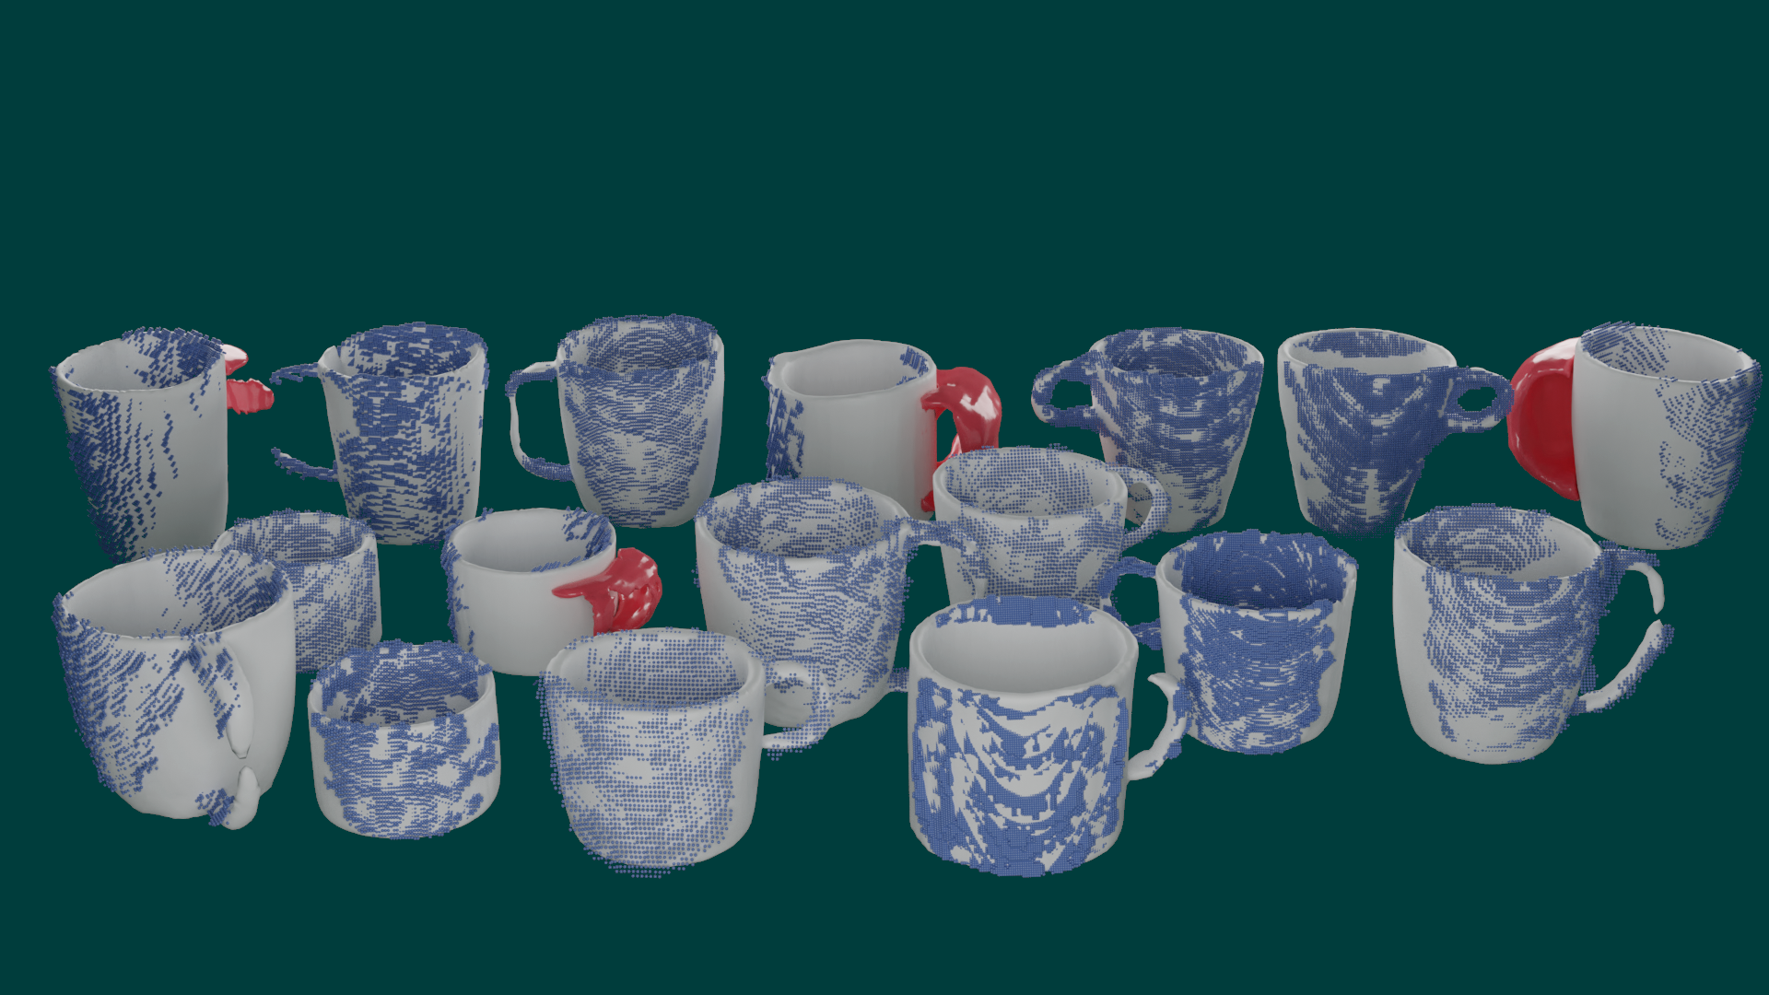
Qualitative Sim2Real Results: Trinary
Notes:
Finally, we show convincing qualitative results on real world data with good sim2real capabilities.
The trinary model predicts reasonable uncertain regions for the limited number of ambiguous views present in the available datasets.

Slide 20
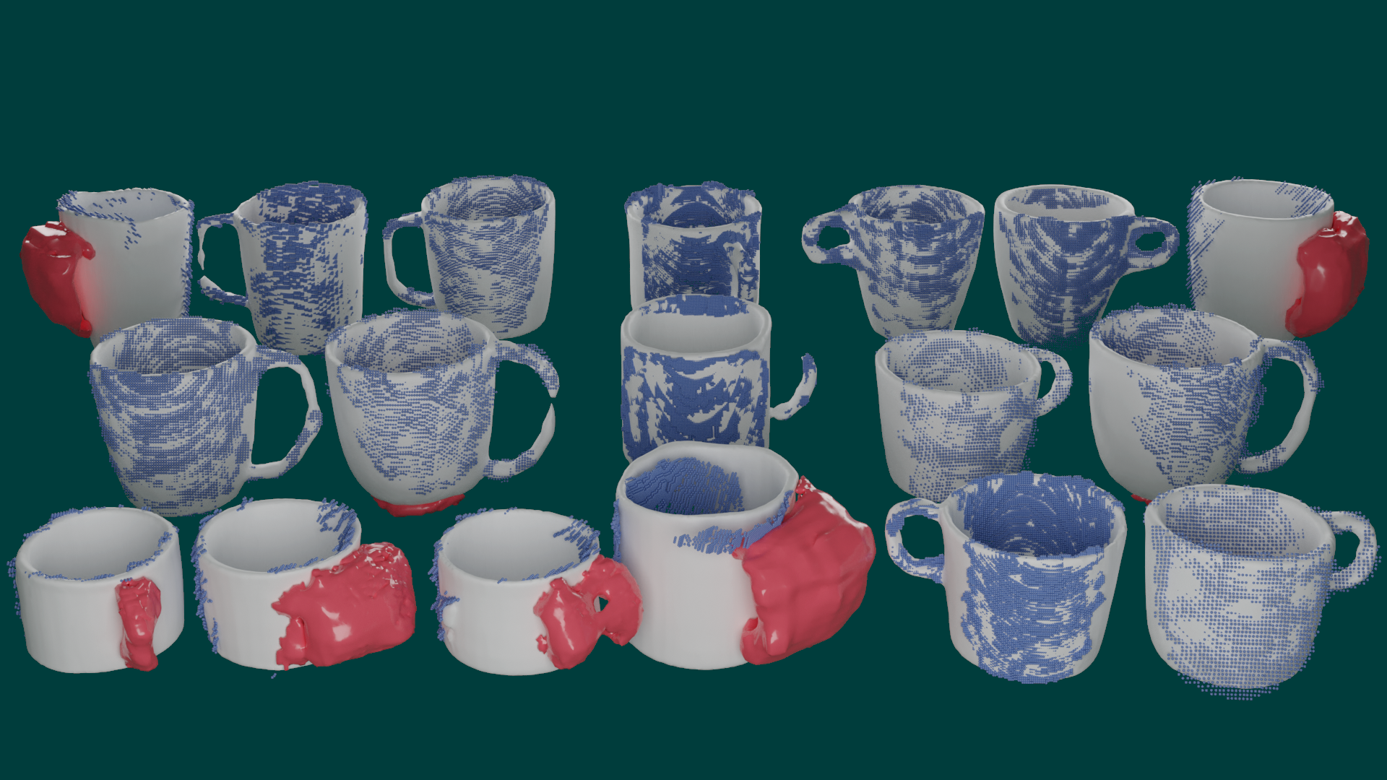
Qualitative Sim2Real Results: Binary
Notes:
Similarly, the binary model can extract sensible, albeit less accurate, uncertain regions, occasionally mixing up pose and general uncertainty.
Quantitative real world results are reported in the paper.

Slide 21


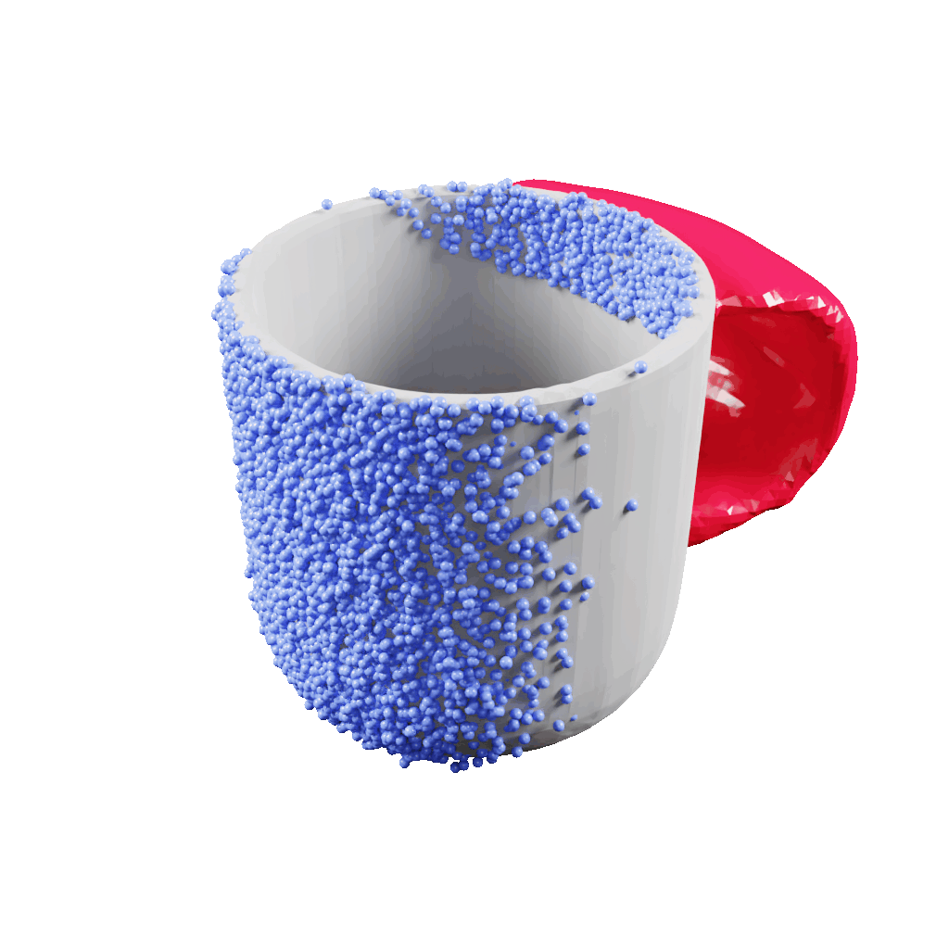
Thank you for your attention!
Paper
Code & Dataset
Poster: MoAIP-12.9
https://arxiv.org/abs/2308.00377
https://github.com/DLR-RM/shape-completion
Notes:
Thank you for your attention!

Slide 22
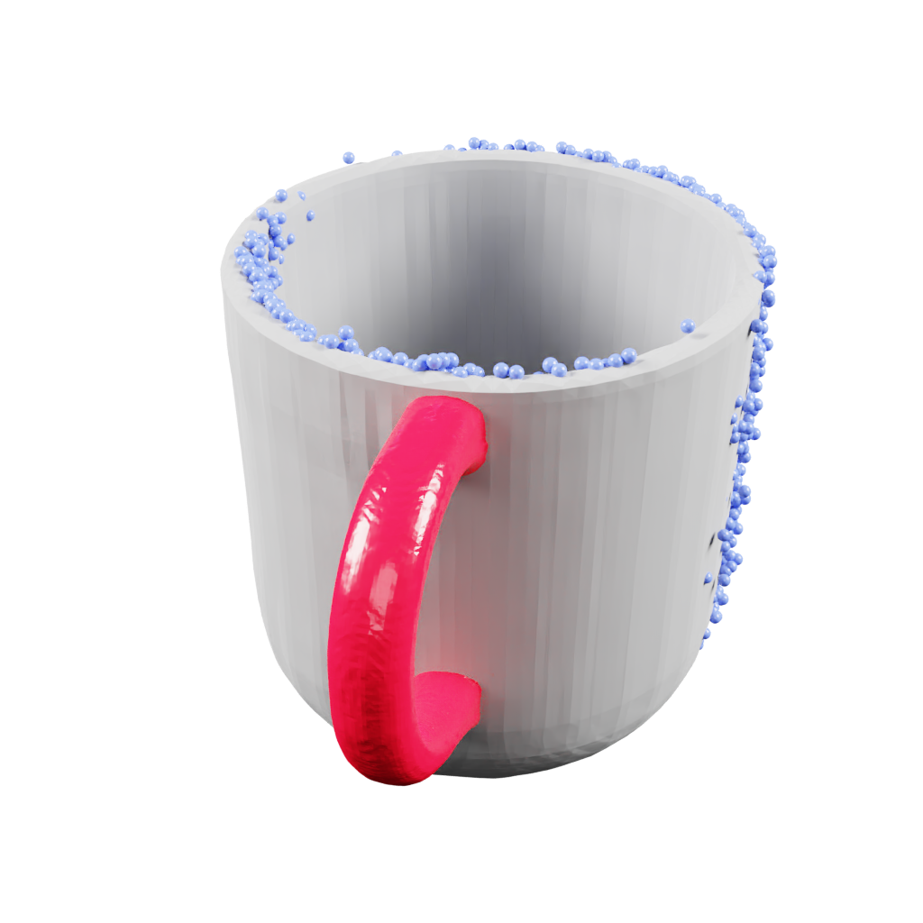

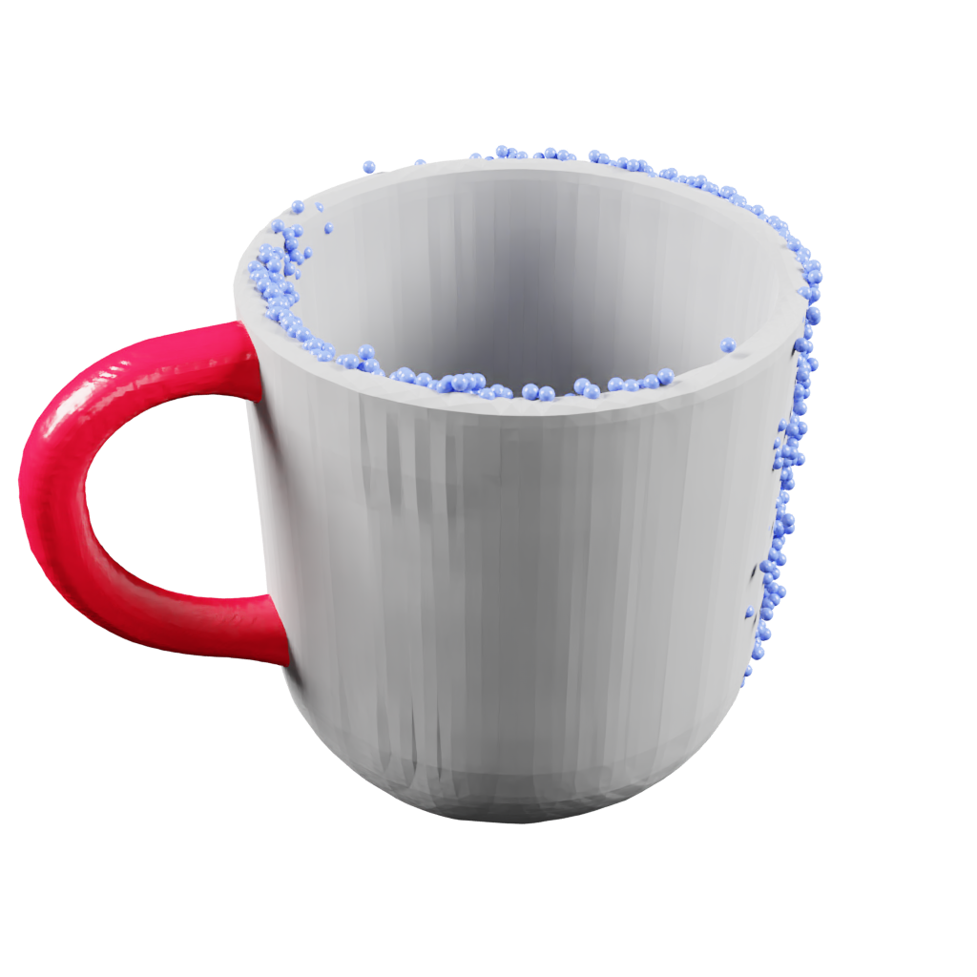
A
Shape Completion
B
Ambiguity
partial input
point cloud
complete mug shape
ambiguous view
possible handle positions
C
Uncertain Regions
D
Application
grasp ignoring uncertain region
grasp considering uncertain region
predicted region containing all possible handle positions

